Slide 1
Using IDEM’s Fixed Station Data
2012 IWLA Group Project
Kyle Vester, Krista Rose, & Gretchen Quirk

Slide 2
Project Statement
Plan ways to put together data from IDEM’s fixed station monitoring program, making it more accessible and user-friendly.
Give examples of how the data can be used by watershed groups to show trends and results.

Slide 3
Background on IDEM Fixed Stations
Started in 1957
Objective: to reveal water quality trends and provide data to surface water users
Currently 176 stations – monthly monitoring
Parameters vary by site – can include Metals, Nutrients, TSS, TDS, DO, pH, Temp, E.coli

Slide 4
Specific parameters are listed in the Indiana Water Monitoring Inventory
Water quality data are stored in IDEM’s Office of Water Quality's Assessment Branch AIMS Database
Data is in Geodatabase that requires most recent version of ArcGIS
Notes:
Describe problems with accessing data (older version of ArcGIS, red-tape with installing demo version, etc) – demonstrates need to make this data more user-friendly

Slide 5
Notes:
Map taken from Indiana Water Monitoring Inventory website

Slide 6
Envision an interactive map that shows location of each fixed station, delineated by watershed.
When site is clicked on, an Excel database opens with all monitoring data for that site.
Could also include graphs that highlight specific parameters to show trends.

Slide 7
Fixed Station Watersheds

Slide 8
Fixed Station Watersheds

Slide 9
Notes:
Comparison with precipitation amounts, could also be done with flow data from USGS monitors

Slide 10
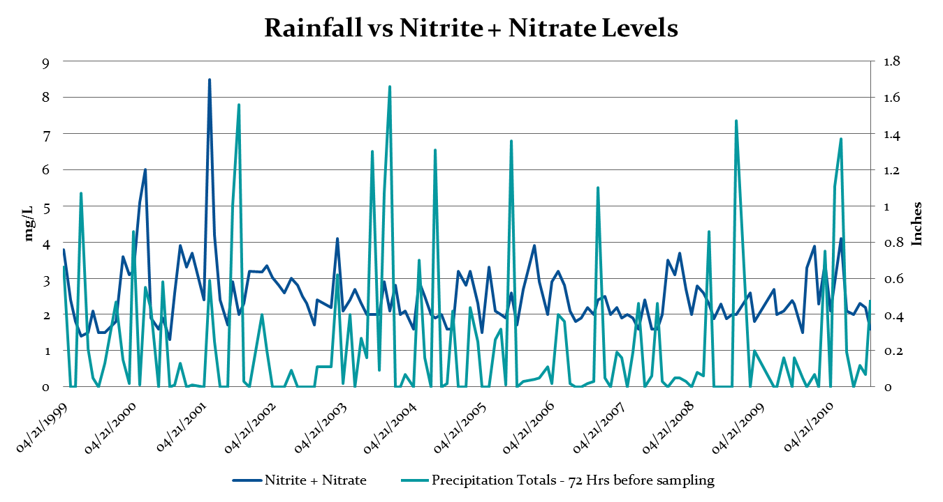

Slide 13
Notes:
Jan, Feb, Mar data missing for 2003.
NH3 only sampled in Apr, May, Jul and Aug

Slide 15
Average Values of Parameters
 | Ammonia | Nitrate+Nitrite | TKN | DO | Total Phosphorus
Jan | -1.00 | 7.32 | 1.84 | 11.38 | 0.16
Feb | -0.20 | 6.62 | 0.92 | 11.90 | 0.10
Mar | -0.40 | 7.00 | 0.78 | 11.48 | 0.06
Apr | -0.60 | 6.79 | 0.85 | 9.20 | 0.06
May | -0.60 | 6.63 | 0.92 | 8.44 | 0.09
Jun | -0.53 | 7.77 | 1.11 | 5.96 | 0.13
Jul | -0.23 | 2.74 | 0.98 | 6.06 | 0.14
Aug | -0.27 | 2.65 | 1.25 | 6.02 | 0.16
Sep | -0.27 | 1.91 | 1.03 | 6.04 | 0.20
Oct | -1.00 | 2.69 | 0.79 | 7.69 | 0.11
Nov | -1.00 | 4.01 | 0.77 | 9.17 | 0.08
Overall (Jan 2002-Nov 2010) | -0.55 | 5.10 | 1.02 | 8.49 | 0.12
Target | 0.00-0.21 mg/L | 1.00 mg/L | 0.59 mg/L | 4.00-12.00 mg/L | 0.30 mg/L
Notes:
The average values in the above table were calculated from all existing data per parameter from Jan 2002 to Nov 2010. Target values were pulled from the water quality targets on IDEM’s website (http://www.in.gov.idem/6242.htm). From this table you can see that the overall average and each monthly average exceeds the target value for Ammonia, Nitrate+Nitrite, and TKN. Total P fell well below the target value and all values feel between the target range of 4-12 mg/L for DO.

Slide 16
Notes:
Graph representation of exceedances: Nitrate+Nitrite overall average above target value 1.0 mg/L, TKN value above target of 0.591 mg/L, DO falls within range of 4-12 mg/L, P below target of 0.3 mg/L

Slide 17
Parameter | Target | Reference/Other Information
Total Ammonia (NH3) | Range between 0.0 and 0.21 mg/L depending upon temperature and pH | Indiana Administrative Code (327 IAC 2-1-6)
Dissolved Oxygen (DO) | Min: 4.0 mg/L Max: 12.0 mg/L | Indiana Administrative Code (327 IAC 2-1-6)
 | Min: 6.0 mg/L in cold water fishery streams | Indiana Administrative Code (327 IAC 2-1.5-8)
Nitrate+Nitrite | Max: 1.0 mg/L | Ohio EPA recommended criteria for Warm Water Habitat (WWH) headwater streams in Ohio EPA Technical Bulletin MAS//1999-1-1 [PDF]
Total Kjeldahl Nitrogen (TKN) | Max: 0.591 mg/L | U.S. EPA recommendation *
Total Phosphorus | Max: 0.3 mg/L | IDEM draft TMDL target
Turbidity | Max: 10.4 NTU | U.S. EPA recommendation
Notes:
http://www.in.gov/idem/6242.htm

Slide 18
ArcGIS Online
Can upload data layers to create you own maps
Limited amount of data can be uploaded
Each item can only contain 1000 features
Our dataset is way too large
Can upload each watershed
Cannot get Excel or Database uploaded
Limited type of data can be uploaded

Slide 19
SQLite
A quick and dirty way to allow for our data to be more publically accessible
Purdue would need to set up a geodatabase server that could be linked to
The data for a particular point can be accessed, or all within a watershed, by using SQL to do query searches

Slide 20
A More Robust Set-up
Purdue (or IDEM) sets up a geodatabase along with a map system
Similar to Driftwatch
A full service map as we envision could be created
Search function
Full data access
Similar to SQL queries, the database could be accessed with data only for the site(s) the user is interested in

Slide 21
Ideas for the future?
Steps needed to finish map
Semester project for an enterprising undergrad or side project for a grad student
Maintain databases, update quarterly/monthly?
Incorporate Hoosier Riverwatch data, possibly other monitoring data to consolidate in one location
Break data out from spreadsheets into sheets for each station
Allows users to look through a list of sites rather than use a map that they may be uncomfortable using

